Slide 1

Better Together: Text + Context Final Presentation
Aug 3, 2023
https://github.com/kwchurch/JSALT_Better_Together

Slide 2
Agenda
1.5 hours
1.5 hours
Intro (Ken) – 20 min
Centroids/Related Work
(Rodolfo) – 15 min
Bins
(Shabnam) – 15 min
Forecasting over time
Losses + Time & Space
Production Runs
(Ben) – 10 min
Time & Space
Break – 30 minutes
Experiments
Perplexity (Abteen) – 20 min
Random Walks (Peter) – 10 min
Local Citation Prediction (Peter) – 10 min
Time prediction (Melissa) – 15 min
GNNs (Sandeep, Hui) – 15 min
Deliverables/Conclusions
(Ken) – 5 minutes
Questions – 15 min

Slide 3
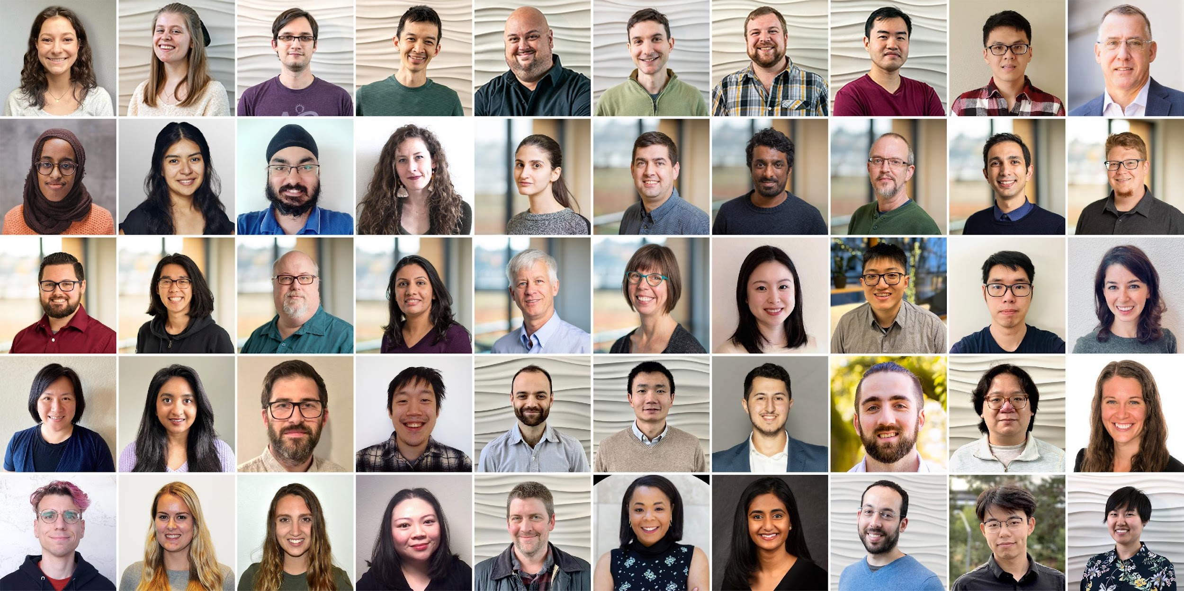
Semantic Scholar (S2): Significant Effort (slide from Dan Weld)
50 person team
7 year project
207M+ scientific paper index
8M+ monthly active users

Slide 4
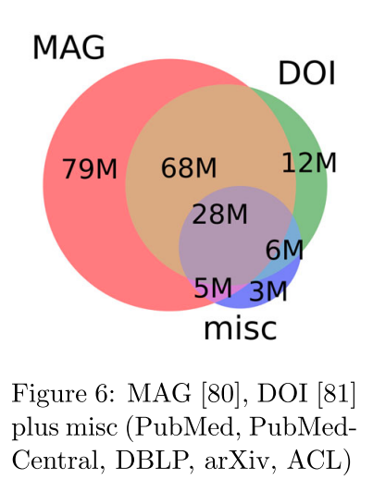
Semantic Scholar (S2)
Seven Sources
Fields of Study
Medicine (45M) | Engineering (8M) | Business (4M) | Geology (3M)
Chemistry (13M) | Physics (7M) | Sociology (3M) | History (2M)
Computer Science (13M) | Psychology (7M) | Geography (3M) | Art (2M)
Biology (13M) | Mathematics (5M) | Economics (3M) | Philosophy (1M)
Materials Science (10M) | Political Science (4M) | Environmental Science (3M)

Slide 5
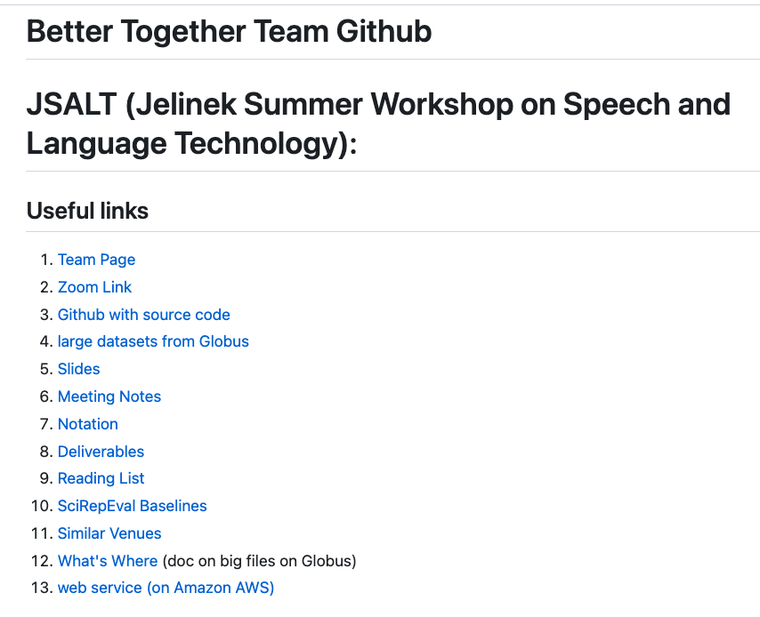
https://github.com/kwchurch/JSALT_Better_Together
including these slides
Web Page

Slide 6
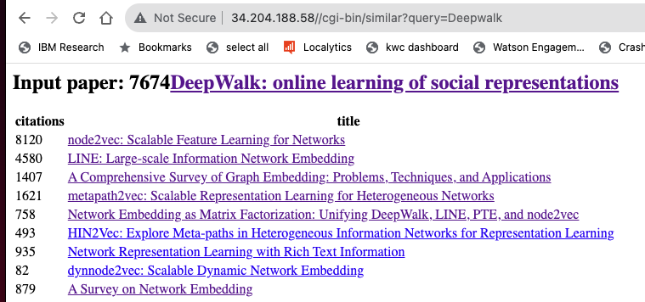

Web Page

Slide 7
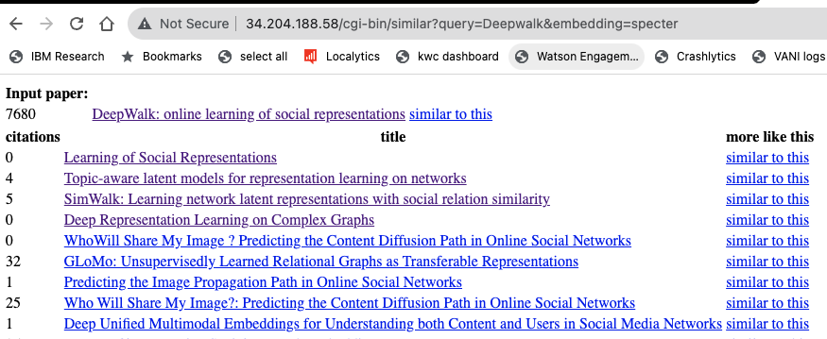
Web Page (Specter)

Slide 8

Better Together: Text (Titles, Abstracts, Body); Context (Citations)
Specter, SciNCL
ProNE

Slide 9
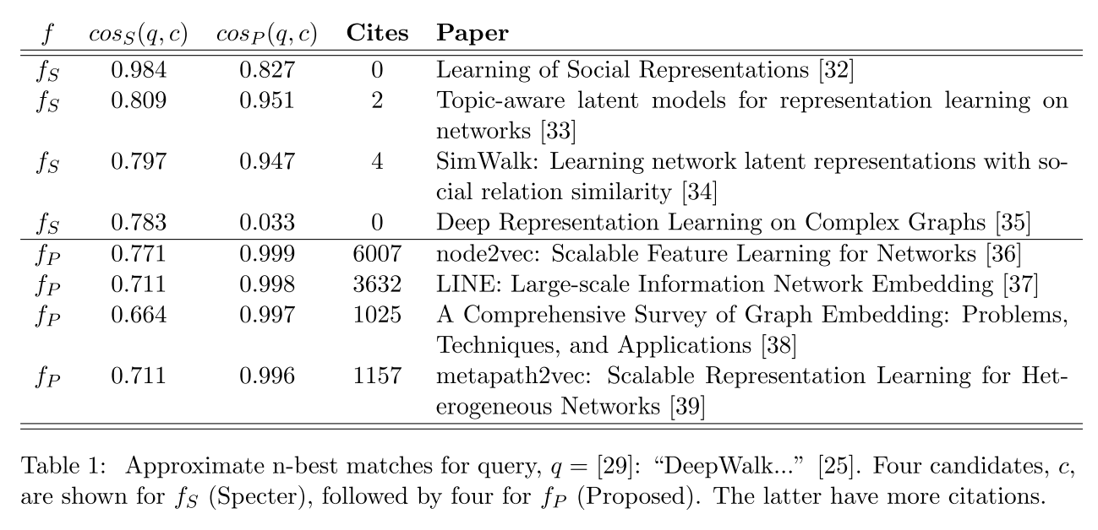
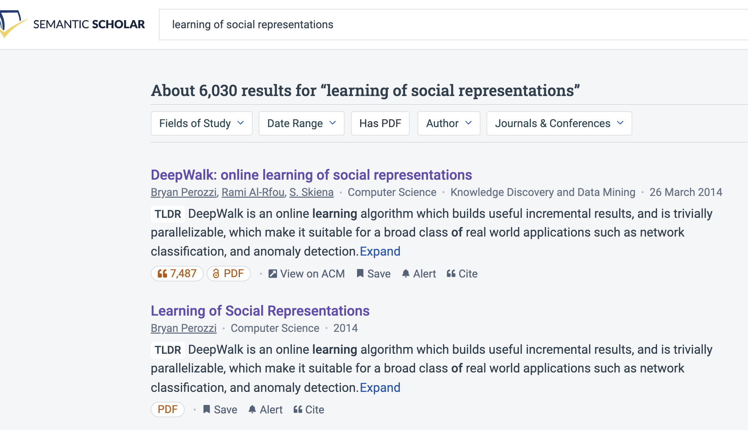
Query: ``DeepWalk: Online Learning of…’’

Slide 10
Recommendation: More than Word Overlap
Recommendations
What should I read?
What should I cite?
Many systems focus on ``relevance’’ (word overlap)
But we also want credibility
Don’t recommend papers that are buzz-word compliant
But not worth reading
(Most papers are never cited)

Slide 11
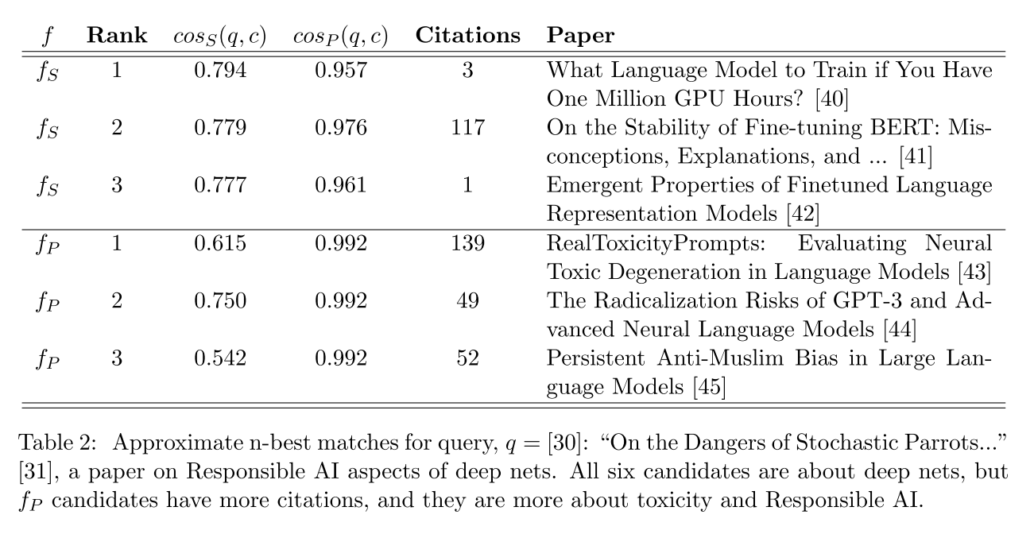
Query: ``On the Dangers of Stochastic Parrots…’’

Slide 12
Deliverables
GitHub:
massive (but needs editing)
slides, code, reading list
pointers to large files on Globus
Web Server
Recommendations
Input: queries for documents
Output: recommendations (docs)
What Should I read? Cite?
Resources
Data behind web server:
citation graph
embeddings
indexes for approx. nearest neighbors
pairs of corpusIds with large cosines
all of the above for
Specter1, Specter2, SciNCL, ProNE
x100 bins for ProNE
Evaluations & Benchmarks
Intrinsic: Perplexity, Random Walks
Extrinsic: Local Citation Prediction

Slide 13
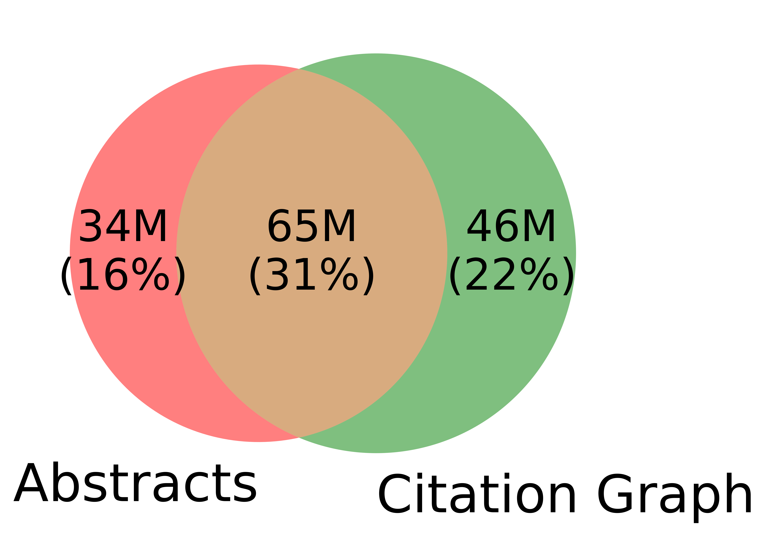
Spoiler Alert: Better-Together Conjectures
Multiple representations are helpful
for missing values (and bad values)
If abstracts are missing, use links
If links are missing, use abstracts
and for graphs of different sizes
When graphs are small (benchmarks):
Text >> Links
when graphs are large:
Links >> Text (Metcalfe’s Law)
Other
31%

Slide 14
Opportunities
Scale
Prediction
Many benchmarks return a single number (figure of merit)
How does performance scale
with the size of the problem?
Standard test/train splits
More relevant to interpolation
than extrapolation
Time is asymmetric
It is difficult to make predictions
especially about the future
-- Yogi Berra

Slide 15
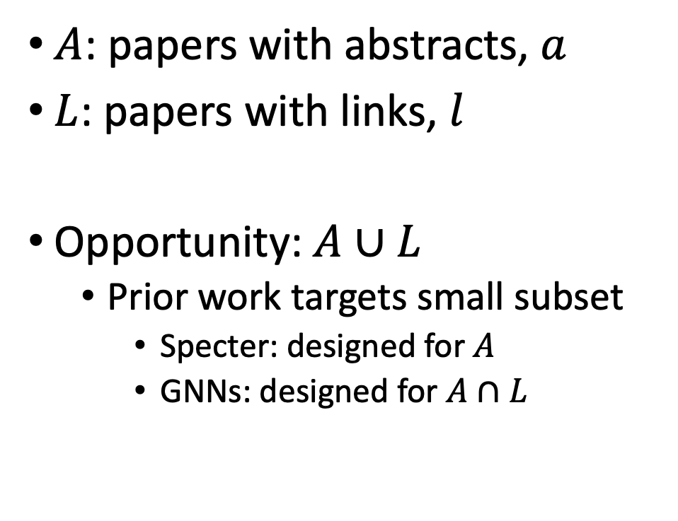
Realities: Missing Values
$A$: papers with abstracts, $a$
$L$: papers with links, $l$
Opportunity:$A∪L$
Prior work targets small subset
Specter: designed for $A$
GNNs: designed for $A∩L$
Other
31%

Slide 16
Opportunity: More Realistic Benchmarks
The Real World
Idealizations (Standard Benchmarks)
Large (Metcalfe’s Law)
Growing (next slide)
Dirty (previous slide)
Missing Values
Bad/misleading Values
Small
Static
Clean

Slide 17
Large & Growing: Doubles Every 9 Years
Standard Benchmarks: OGB
Small: 3M << 200M
Static: Frozen since KDD-2021
https://arxiv.org/abs/2103.09430
Timeliness
Web companies keep indexes up to date (web is a moving target)
Ditto for Academic Search

Slide 18
Standard Benchmarks (e.g., OGB, SciRepEval) are Small, Static & Clean
OGB (Open Graph Benchmark)
S2 (Semantic Scholar)
https://arxiv.org/pdf/2005.00687.pdf
Nodes (papers): 3M (small)
Static
(Frozen for KDD-2021 CUP)
Train: before 2017
Validation: 2018
Test: 2019
Nearly all papers have both
Vectors (from word2vec)
Links (from citation graph)
Nodes (papers): 200+ M
Dynamic
Doubles every 9 years
Many papers with missing values
Many missing vectors
(because of missing abstracts)
Many missing links

Slide 19
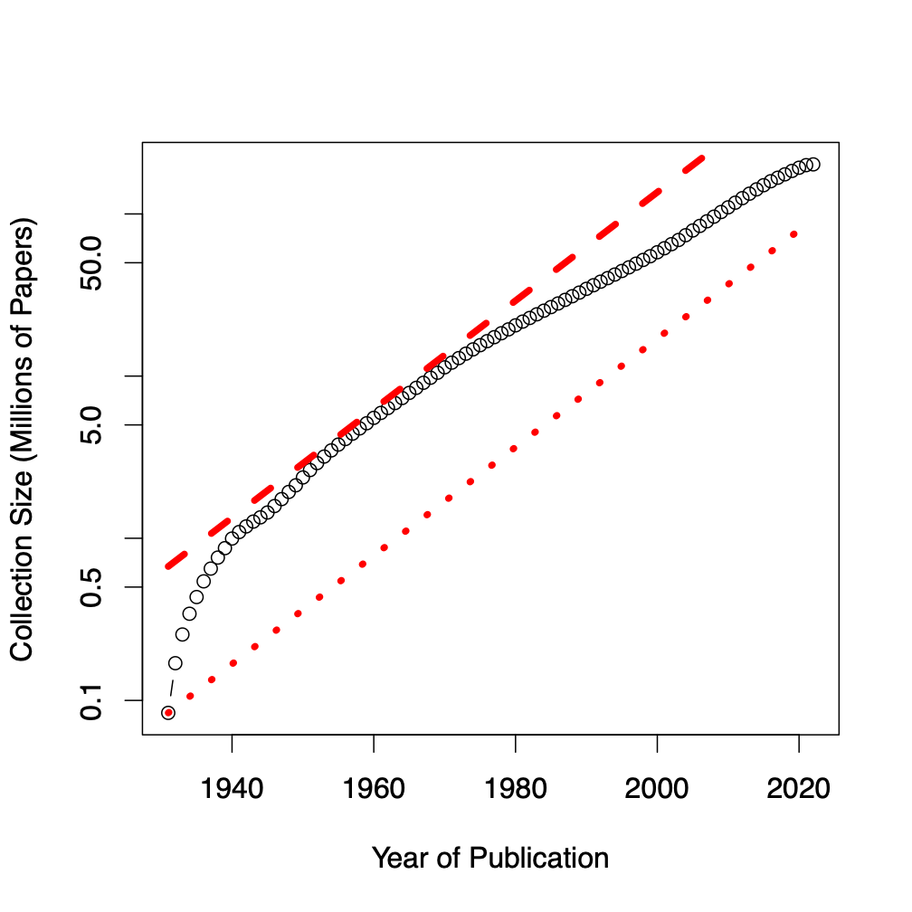
Benchmarks
Dataset | #N | #E | Node Raw Features
ogbl-citation2 | 3M | 31M | 128 (eg. word2vec)
Semantic scholar | 200M | 2B | 768 (eg. Bert)
GBs → TBs
Notes:
Graph showing growth

Slide 20
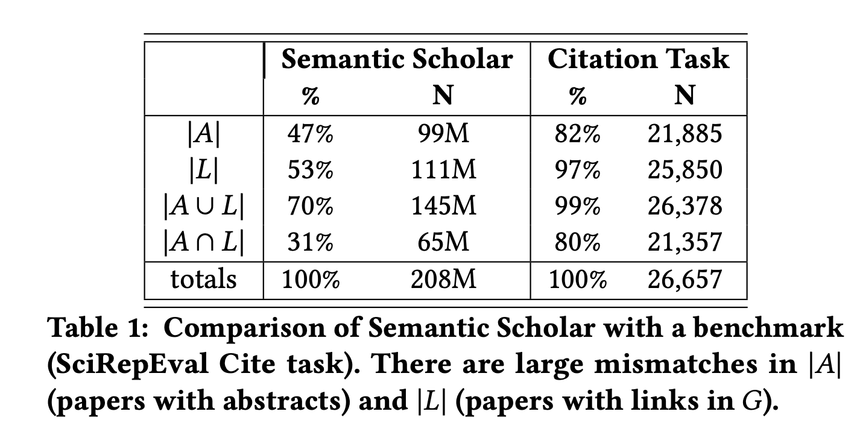
Standard Benchmarks are Small, Static & Clean
S2 (Semantic Scholar)
SciRepEval: Fewer Missing Values

Slide 21
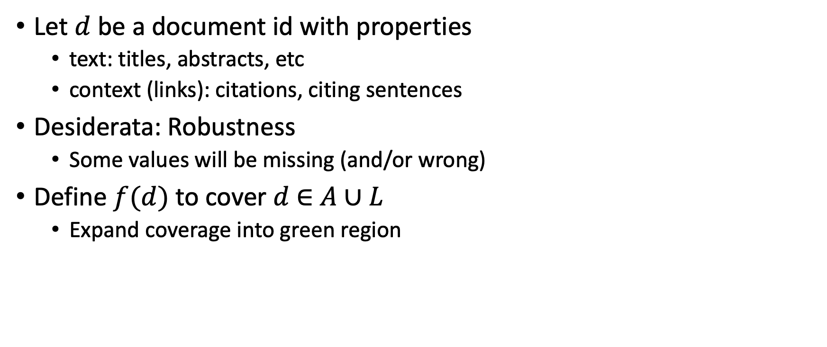

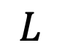
Suggestion for Missing Values
Let $d$ be a document id with properties
text: titles, abstracts, etc
context (links): citations, citing sentences
Desiderata: Robustness
Some values will be missing (and/or wrong)
Define $f(d)$ to cover $d$ $∈$ $A∪L$
Expand coverage into green region
$$A$$
$$L$$

Slide 22
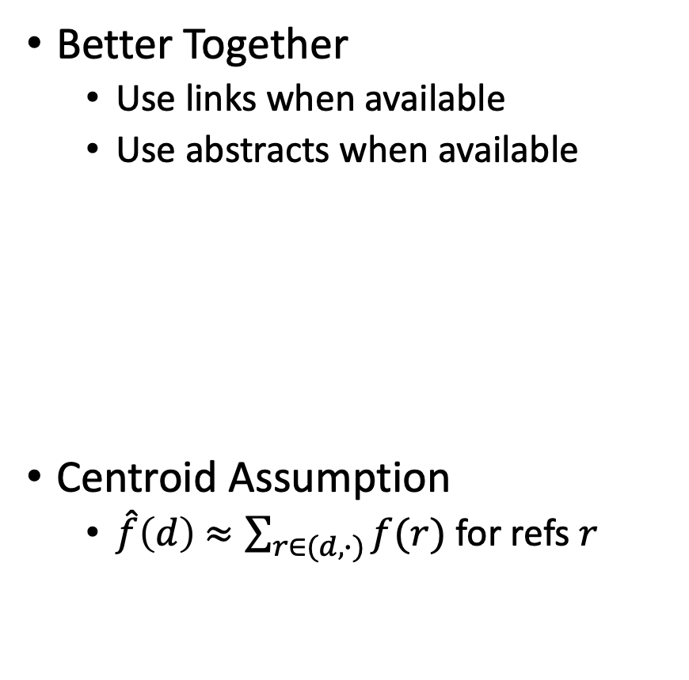

Estimates of $f(d)$ for $d$ $∉$ training set
It has been suggested that Link-based methods
do not generalize to documents beyond training set
Two methods for generalizing
Better Together
Centroid Assumption
Rodolfo & Peter
Better Together
Use links when available
Use abstracts when available
Centroid Assumption
$\hat{f}\left(d\right)$ $≈\sum_{r∈(d,∙)}{f(r)}$ for refs $r$

Slide 23
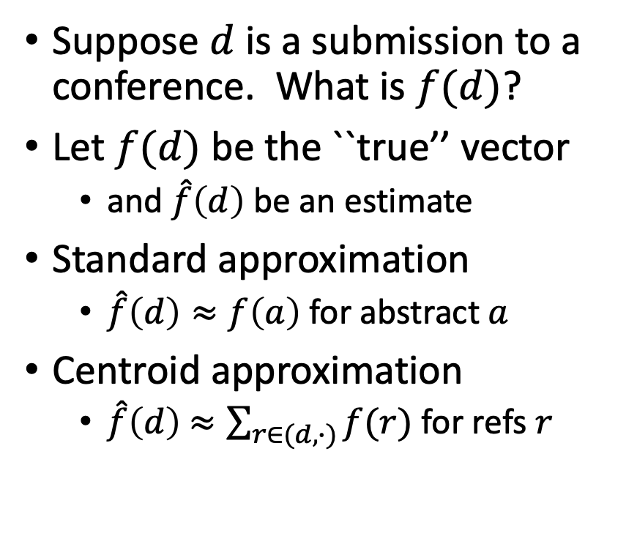
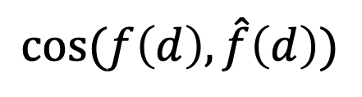
Centroid Assumption
Evidence for Centroid Approximation
$$cos⁡(f\left(d\right), \hat{f}\left(d\right))$$
Suppose $d$ is a submission to a conference. What is $f(d)$?
Let $f(d)$ be the ``true’’ vector
and $\hat{f}\left(d\right)$ be an estimate
Standard approximation
$\hat{f}\left(d\right)≈f\left(a\right)$ for abstract $a$
Centroid approximation
$\hat{f}\left(d\right)$ $≈\sum_{r∈(d,∙)}{f(r)}$ for refs $r$

Slide 24
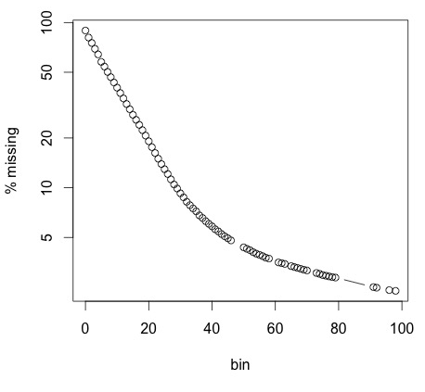
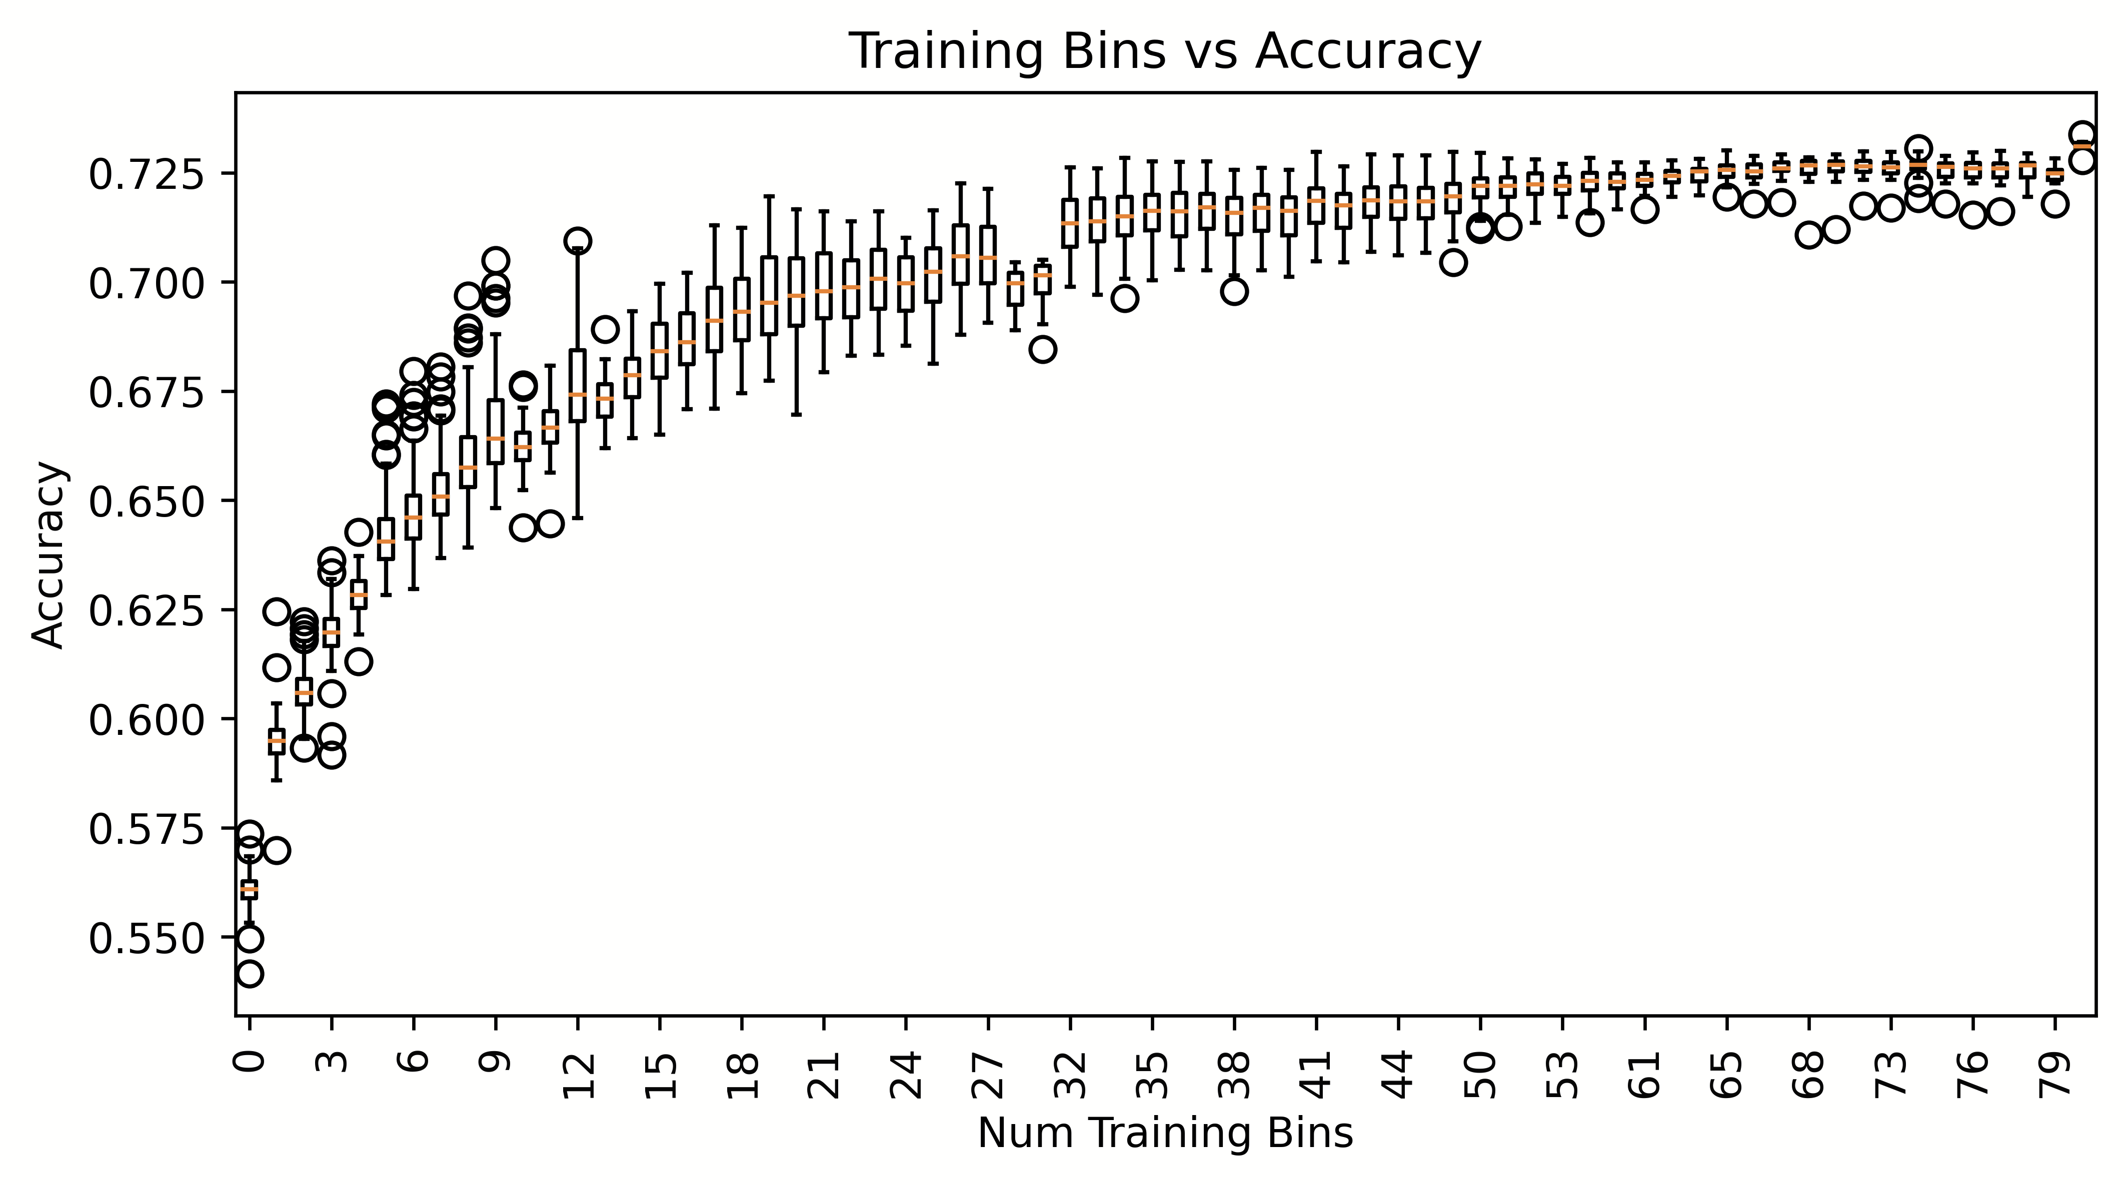
Proposal: Bins (Shabnam)
Research Questions:
How does performance/coverage scale
with size of citation graph?
How do losses scale with time?
Weather forecasting:
Short-term is easier than long-term
Better together:
Multiple reps → Ensembles
Production Runs
100x more work
Coverage
Peter
Ben
Performance

Slide 25
Resources & Evaluations: How do losses scale with size of citation graph?
We will distribute
Bins: CorpusIds
Graphs & Embeddings for bins
with indexes for ANN
Benchmarks for Experiments
Intrinsic
Perplexity
Random Walk
Year Prediction
Related-Work Hypothesis
Extrinsic
Local Citation Prediction
Experimental Results
Perplexity Experiments
Abteen
Random Walk Experiments
Peter, Ken
Link Prediction Experiments
Peter
Year Prediction
Melissa, Shabnam
Related-Work Hypothesis
Rodolfo, John

Slide 26
How do time and space scale with size of graph?
Embeddings
Standard Embeddings
Specter, SciNCL, LinkBERT
Proposed embedding (ProNE)
Ben, Ken

Slide 27
Approximate Nearest Neighbors in External Memory
Kenneth Church

Slide 28
Opportunity for Publication
Well established:
Memory resident solutions (annoy)
Novelty:
External memory
mmap
Embarrassingly parallel
Standard evaluation benchmark
https://ann-benchmarks.com/
May not address advantages of proposed solution
Indexing time: small memory footprint during indexing, embarrassingly parallel
Inference time: small memory footprint, quick startup

Slide 29
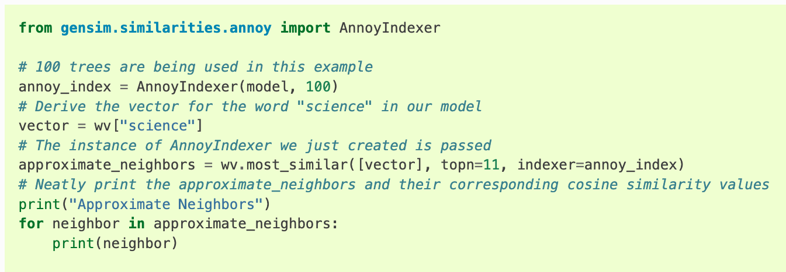
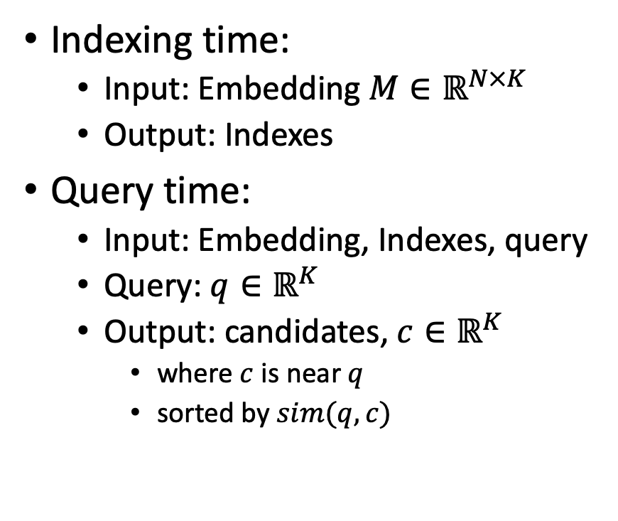
Processing with Embeddings: Annoy / Faiss Approximate Nearest Neighbors (ANN)
Indexing time:
Input: Embedding $M∈ℝ^{N×K}$
Output: Indexes
Query time:
Input: Embedding, Indexes, query
Query: $q∈ℝ^{K}$
Output: candidates, $c∈ℝ^{K}$
where $c$ is near $q$
sorted by $sim(q,c)$
https://radimrehurek.com/gensim/auto_examples/tutorials/run_annoy.html

Slide 30
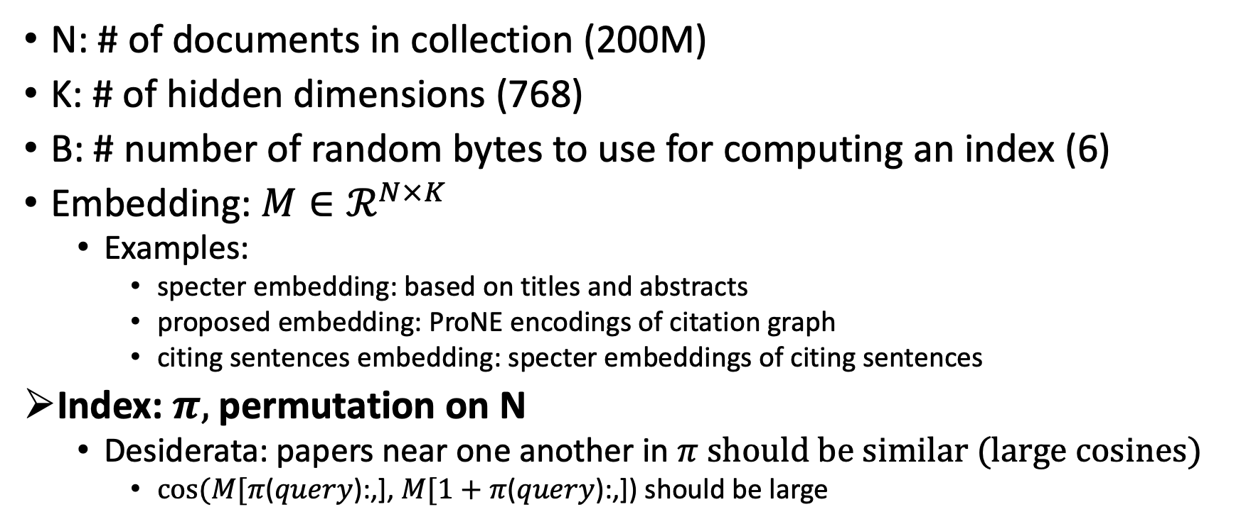
Notation
N: # of documents in collection (200M)
K: # of hidden dimensions (768)
B: # number of random bytes to use for computing an index (6)
Embedding: $M∈ℛ^{N×K}$
Examples:
specter embedding: based on titles and abstracts
proposed embedding: ProNE encodings of citation graph
citing sentences embedding: specter embeddings of citing sentences
Index: $π,$permutation on N
Desiderata: papers near one another in $π$ should be similar (large cosines)
$cos⁡(M[π$($query$):,], $M[1+π$($query$):,]) should be large

Slide 31
Memory Mapping (mmap in C; numpy.memmap in Python)
def map_int64(fn):
fn_len = os.path.getsize(fn)
return np.memmap(fn, dtype=np.int64, shape=(int(fn_len/8)), mode='r')
longs = (long *)mmapfile(av[++i], &nlongs);
nlongs /= sizeof(long);
Loads a large file (embedding) quickly
by adding file on disk to page table (without copying the contents)
returns a pointer to the contents (and the size of object in bytes)
If you dereference a pointer to virtual memory,
there could be a page fault (if the page is not in physical memory)

Slide 32
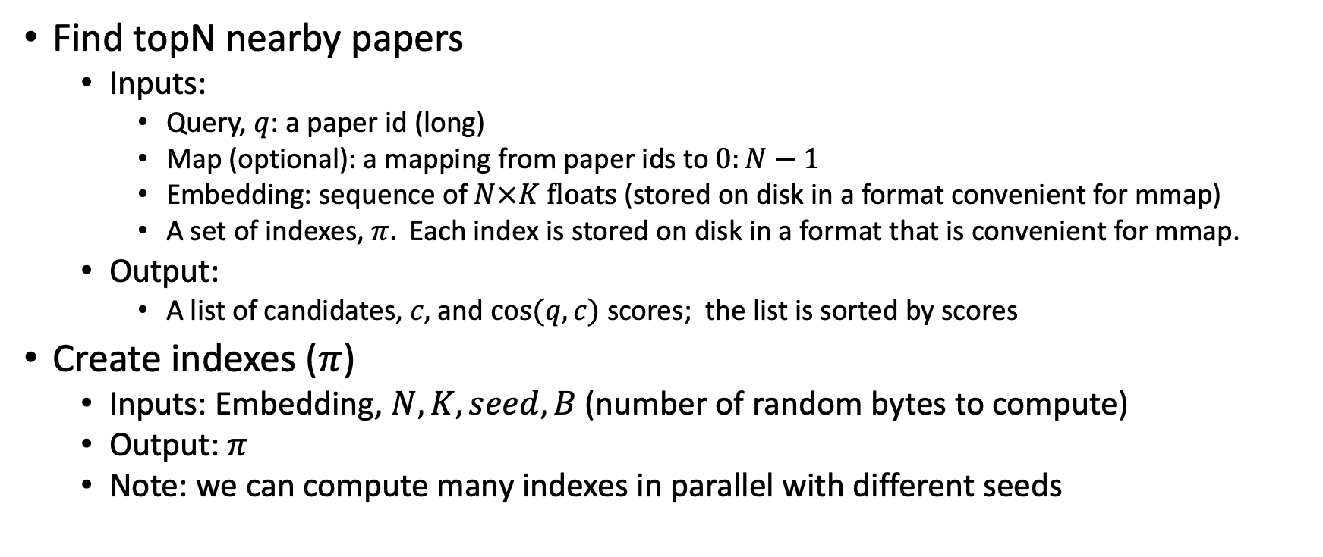
Problems to be done in external memory (Avoid loading embedding into memory)
Find topN nearby papers
Inputs:
Query, $q$: a paper id (long)
Map (optional): a mapping from paper ids to $0:N−1$
Embedding: sequence of $N×K floats$ (stored on disk in a format convenient for mmap)
A set of indexes, $π.$ Each index is stored on disk in a format that is convenient for mmap.
Output:
A list of candidates, $c,$ and $cos⁡(q,c)$ scores; the list is sorted by scores
Create indexes ($π$)
Inputs: Embedding, $N, K, seed, B$(number of random bytes to compute)
Output: $π$
Note: we can compute many indexes in parallel with different seeds

Slide 33

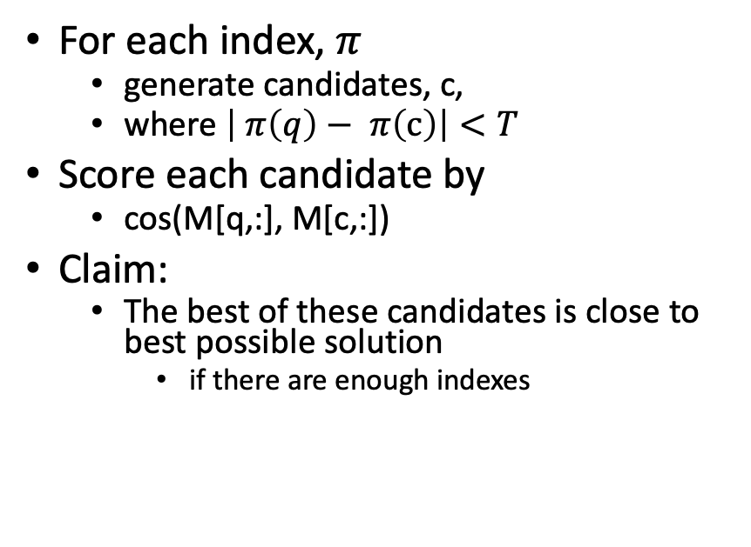
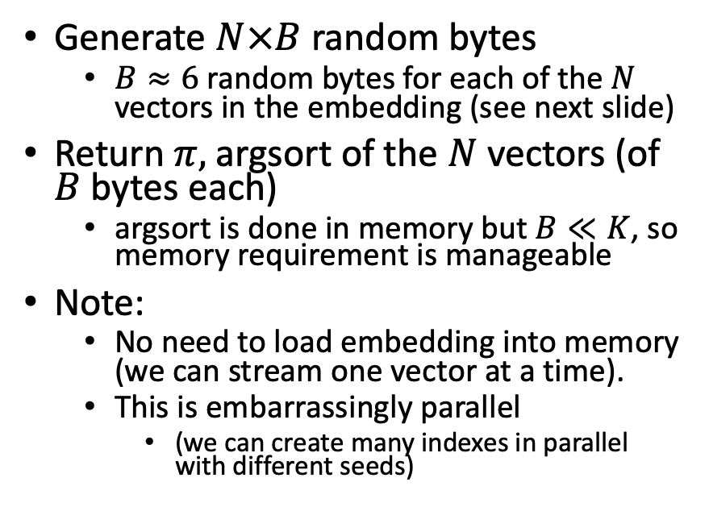
Solutions
Find topN nearby papers (easy)
Create index $π$
For each index, $π$
generate candidates, c,
where $\left| π\left(q\right)− π\left(c\right)\right|<T$
Score each candidate by
cos(M[q,:], M[c,:])
Claim:
The best of these candidates is close to best possible solution
if there are enough indexes
Generate $N×B$ random bytes
$B≈6$ random bytes for each of the $N$ vectors in the embedding (see next slide)
Return $π,$argsort of the $N$vectors (of $B$ bytes each)
argsort is done in memory but $B≪K$, so memory requirement is manageable
Note:
No need to load embedding into memory (we can stream one vector at a time).
This is embarrassingly parallel
(we can create many indexes in parallel with different seeds)

Slide 34
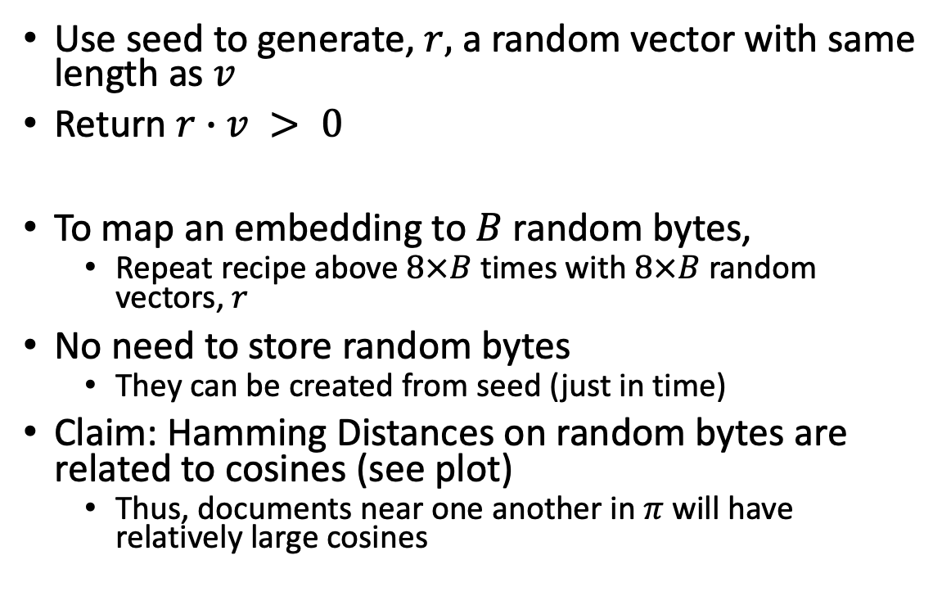

Method for mapping vector, $v$, to 1 bit
Use seed to generate, $r,$ a random vector with same length as $v$
Return $r∙v > 0$
To map an embedding to $B$ random bytes,
Repeat recipe above $8×B$ times with $8×B$ random vectors, $r$
No need to store random bytes
They can be created from seed (just in time)
Claim: Hamming Distances on random bytes are related to cosines (see plot)
Thus, documents near one another in $π$ will have relatively large cosines

Slide 35
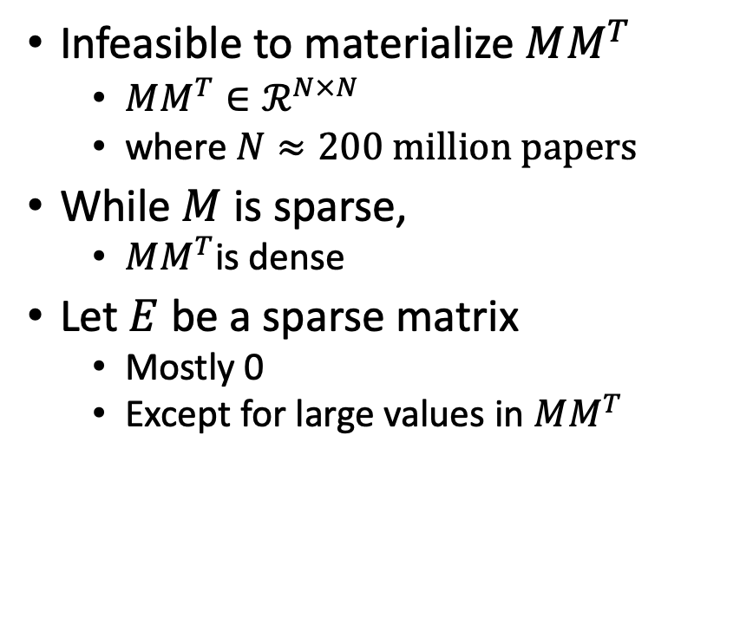

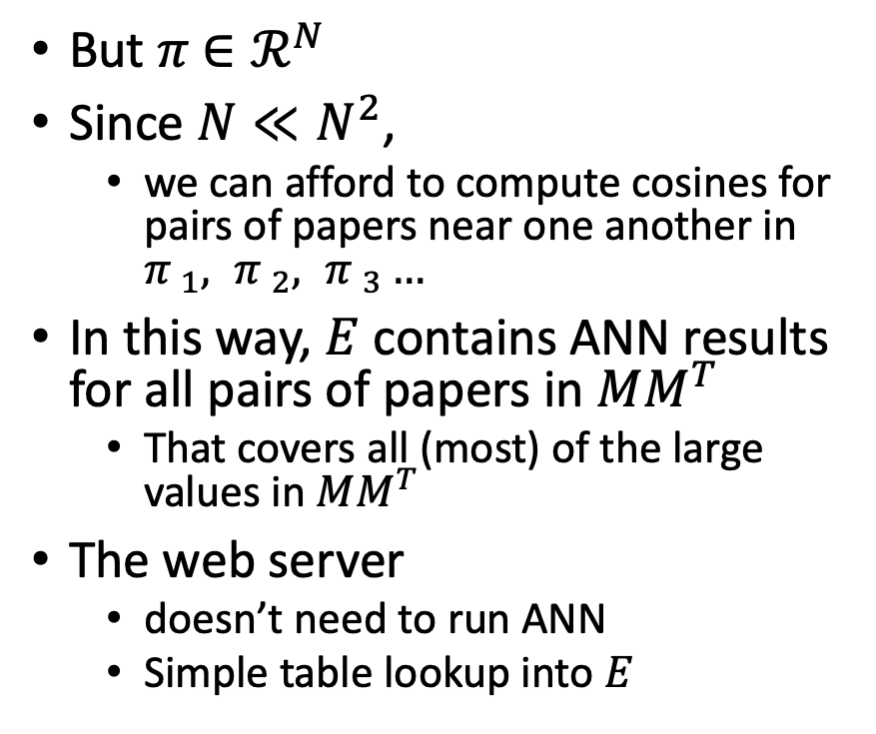
Materializing large values in $MM^{T}$
Infeasible to materialize $MM^{T}$
$MM^{T}∈ℛ^{N×N}$
where $N≈200 million papers$
While $M$ is sparse,
$MM^{T}$is dense
Let $E$ be a sparse matrix
Mostly 0
Except for large values in $MM^{T}$
But $π$ $∈ℛ^{N}$
Since $N≪N^{2}$,
we can afford to compute cosines for pairs of papers near one another in ${π }_{1}, {π }_{2}, {π }_{3}…$
In this way, $E$ contains ANN results for all pairs of papers in $MM^{T}$
That covers all (most) of the large values in $MM^{T}$
The web server
doesn’t need to run ANN
Simple table lookup into $E$

Slide 36
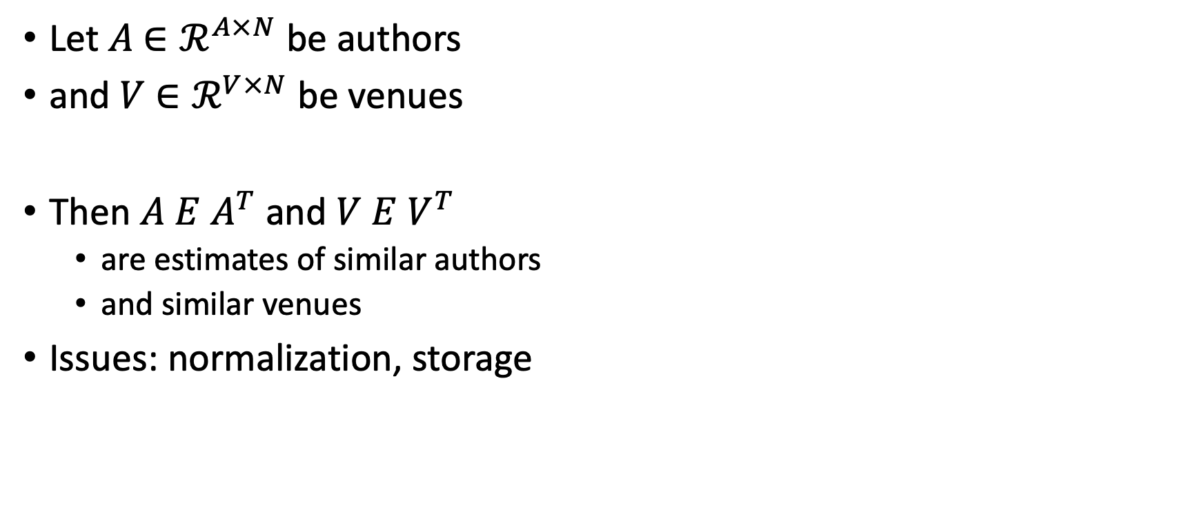
Similar Authors, Venues, etc.
Let $A$ $∈ℛ^{A×N}$ be authors
and $V$ $∈ℛ^{V×N}$ be venues
Then $A E$ $A^{T}$ and $V E$ $V^{T}$
are estimates of similar authors
and similar venues
Issues: normalization, storage

Slide 37
Conclusions/Deliverables
GitHub:
massive (but needs editing)
slides, code, reading list
pointers to large files on Globus
Web Server
Recommendations
Input: queries for documents
Output: recommendations (docs)
What Should I read? Cite?
Resources
Data behind web server:
citation graph
embeddings
indexes for approx. nearest neighbors
pairs of corpusIds with large cosines
all of the above for
Specter1, Specter2, SciNCL, ProNE
x100 bins for ProNE
Evaluations & Benchmarks
Intrinsic: Perplexity, Random Walks
Extrinsic: Local Citation Prediction

Slide 38
Agenda
1.5 hours
1.5 hours
Intro (Ken) – 20 minutes
Centroids/Related Work
(Rodolfo) – 15 minutes
Bins
(Shabnam) – 15 minutes
Forecasting over time
Losses + Time & Space
Production Runs
(Ben) – 10 minutes
Time & Space
Break – 30 minutes
Experiments
Perplexity (Abteen) – 20 minutes
Random Walks (Peter) – 10 minutes
Link Prediction (Peter) – 10 minutes
Time prediction (Melissa) – 15 minutes
GNNs (Sandeep, Hui) – 15 minutes
Deliverables/Conclusions
(Ken) – 5 minutes
Questions – 15 minutes

Slide 39
The Case for Bins
Shabnam

Slide 40
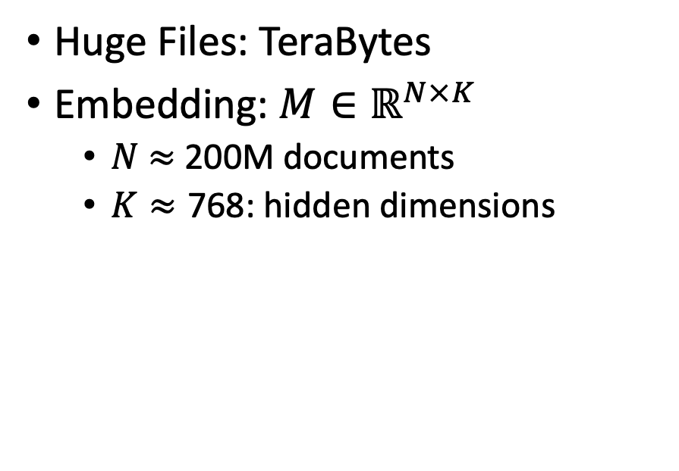
Scale: Both a Blessing and a Curse
Curse (Ben’s Problem)
Blessing (Abteen & Peter’s Lucky Day)
Huge Files: TeraBytes
Embedding: $M∈ℝ^{N×K}$
$N$ $≈$ 200M documents
$K≈\text{768}$: hidden dimensions
Network Effects (Metcalfe’s Law)
Rich get richer (next slide)
More good stuff to find

Slide 41


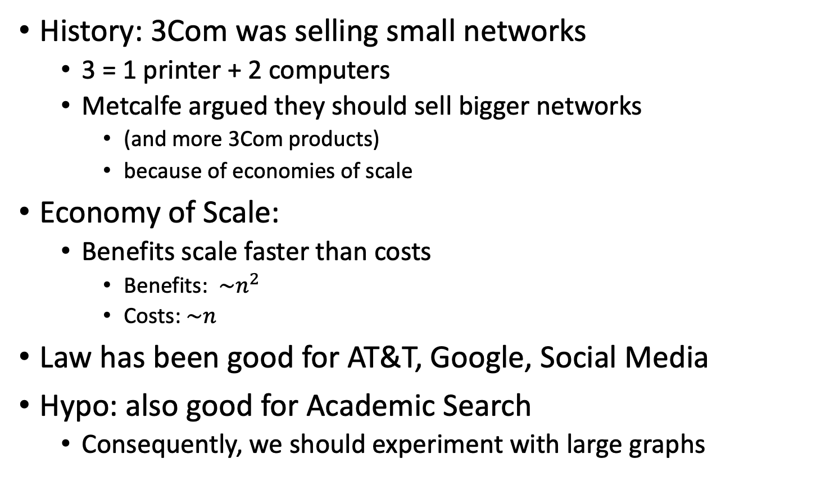
Metcalfe’s Law (Network Effects)
History: 3Com was selling small networks
3 = 1 printer + 2 computers
Metcalfe argued they should sell bigger networks
(and more 3Com products)
because of economies of scale
Economy of Scale:
Benefits scale faster than costs
Benefits: $\sim n^{2}$
Costs:$\sim n$
Law has been good for AT&T, Google, Social Media
Hypo: also good for Academic Search
Consequently, we should experiment with large graphs

Slide 42
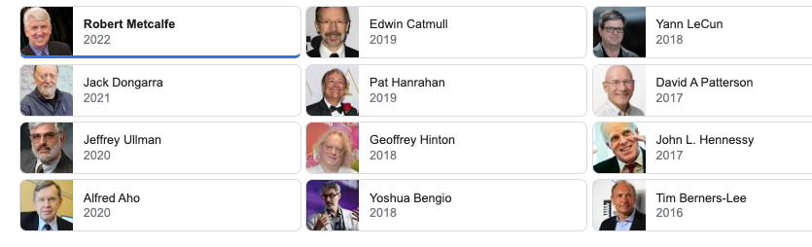
Turing Award/Winners

Slide 43
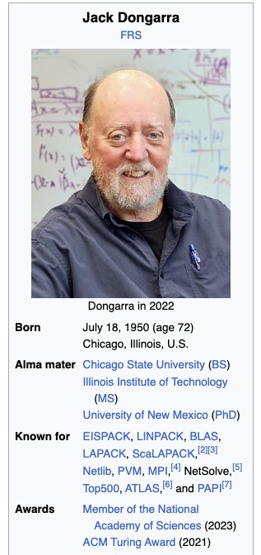
Turing Awards: Metcalfe’s Law, Deep Nets, Linear Algebra
Metclalfe’s Law: Metcalfe
Deep Nets: Hinton, Bengio, LeCun
Linear Algebra: Dongarra

Slide 44
Opportunities
Encourage practical solutions to real problems
Recommendations: What should I read? Cite?
Too many benchmarks are unrealistic (small, clean)
Realities
Literature is large and growing (doubles every 9 years)
Dirty Data (many values are missing/incorrect)
Scale
How do space, time and loss scale with size of citation graph?
Forecasting: short-term predictions are easier than long-term

Slide 45
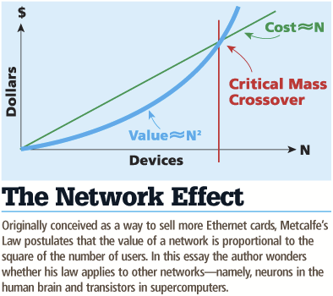
Network Effects: What is the Power of Scale?
Many benchmarks return a single number (figure of merit)
How performance scales with time and the size of the problem
Metcalfe's Law is a blessing
Cost scales in N, benefit scales in N^2
There is an opportunity for academics to benefit from the network effect

Slide 46
Spoiler Alert: Better-Together Conjectures
Multiple representations are helpful
for missing values (and bad values)
If abstracts are missing, use links
If links are missing, use abstracts
and for graphs of different sizes
When graphs are small (benchmarks):
Text >> Links
when graphs are large:
Links >> Text (Metcalfe’s Law)
Other
(31%)

Slide 47
What is the Effect of Scale and Time?
Encourage practical solutions to real problems
Recommendations: What should I read? Cite?
Too many benchmarks are unrealistic (small, clean)
Realities
Literature is large and growing (doubles every 9 years)
Dirty Data (many values are missing/incorrect)
Scale
How do space, time, and loss scale with size of citation graph?
Forecasting: short-term predictions are easier than long-term

Slide 48
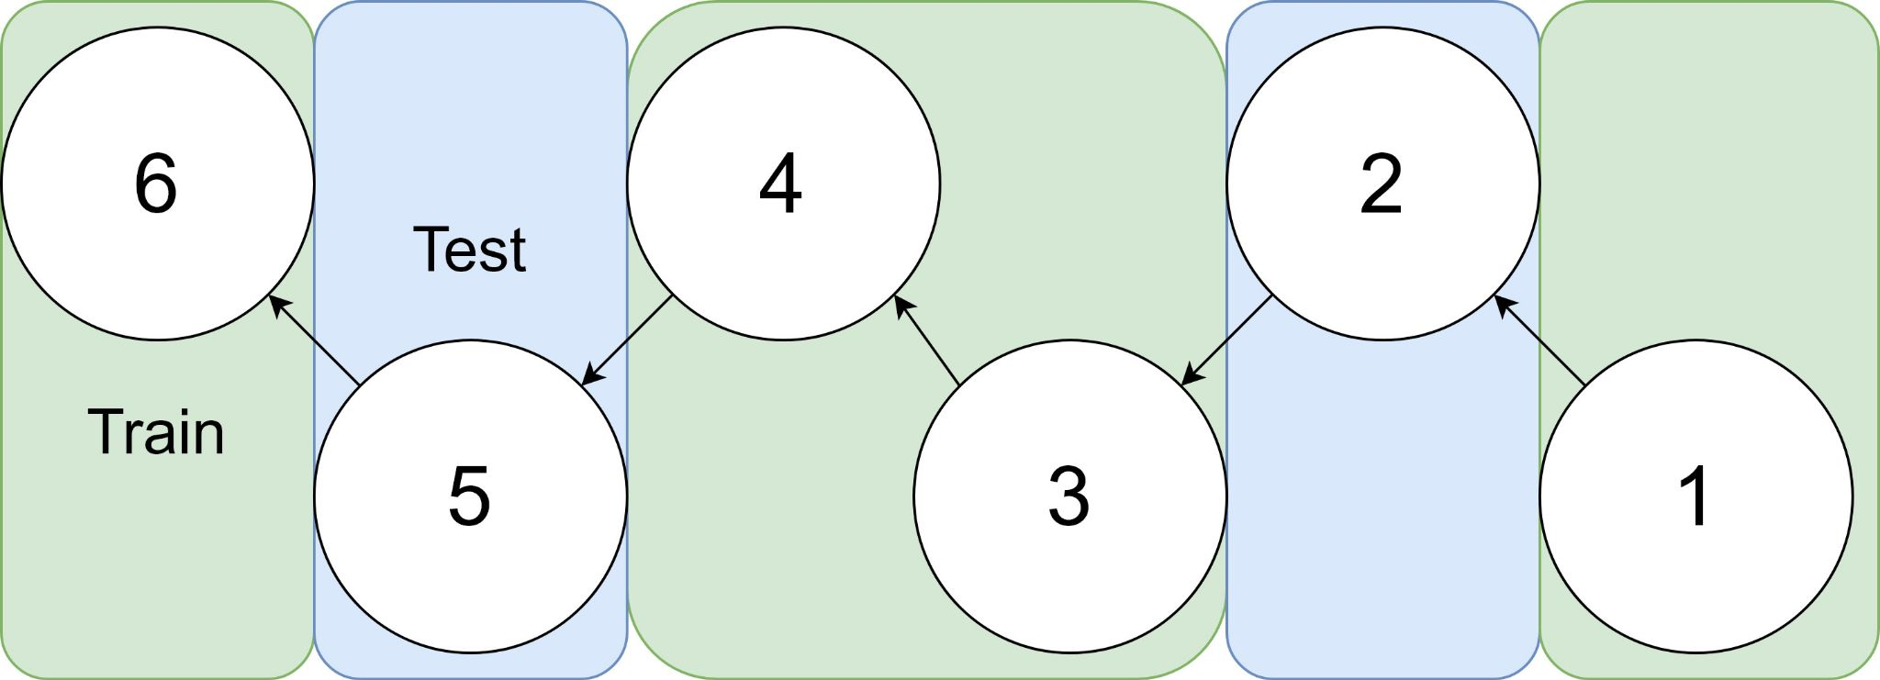
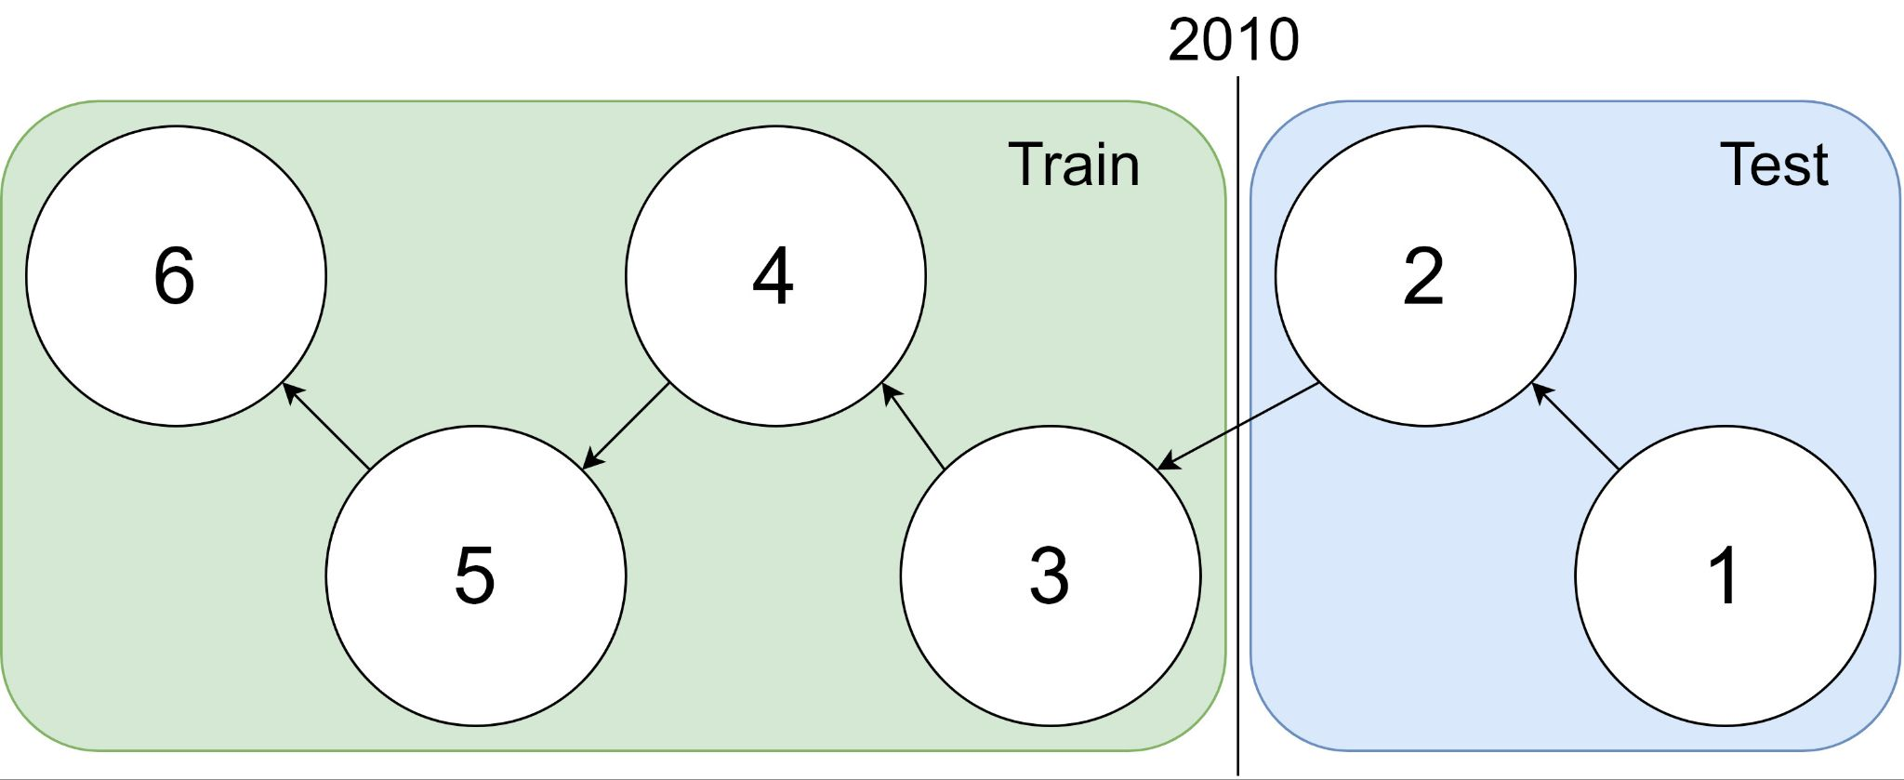
Example: 1 cites 2, 2 cites 3, … 5 cites 6
Traditional Train-Test Split (Non-Causal)
idx | Pub Year | Paper Title
1 | 2018 | [...] Photofragment imaging
2 | 2016 | Convenient probe of S(1D2)[...]
3 | 2005 | Megapixel ion imaging [...]
4 | 2003 | Direct current slice imaging [...]
5 | 1995 | profiles of Cl(2Pj) photofragments [...]
6 | 1988 | Adiabatic dissociation of [...]
Proposed Train-Test Splits (Causal)
Notes:
No asymmetry of time - how to reduce to a soundbite
Audience soundbites
‘Almost all studies in ml do test-train split’ that’s a bad idea when you have time

Slide 49
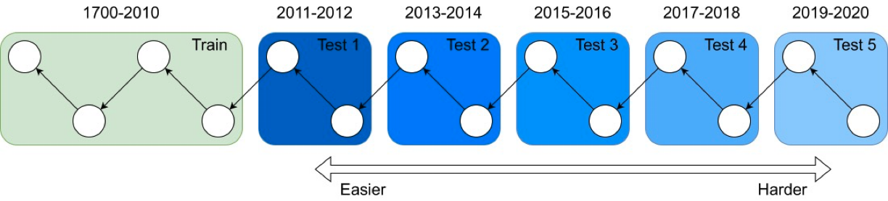
It's tough to make predictions, especially about the future ― Yogi Berra
Forecasting: short-term predictions are easier than long-term

Slide 50
Assign 200M papers to 100 bins (by time)
Sort 200M papers by publication date
Output: Split papers into 100 bins, with 2M papers/bin
Because of exponential growth
(literature doubles every 9 years)
older bins span more time, and
newer bins span less time
Bin 99
………
Bin 0
Time
Notes:
mention equal # papers
consider replacing w/ diagram

Slide 51
Create 100 ProNE Embeddings
Create a graph for each bin
Graph contains the papers in the bin (plus their edges)
Create a cumulative graph for each bin
Sum graphs for the current bin, plus all previous bins
100 ProNE Embeddings:
Run ProNE on 100 cumulative graphs

Slide 52
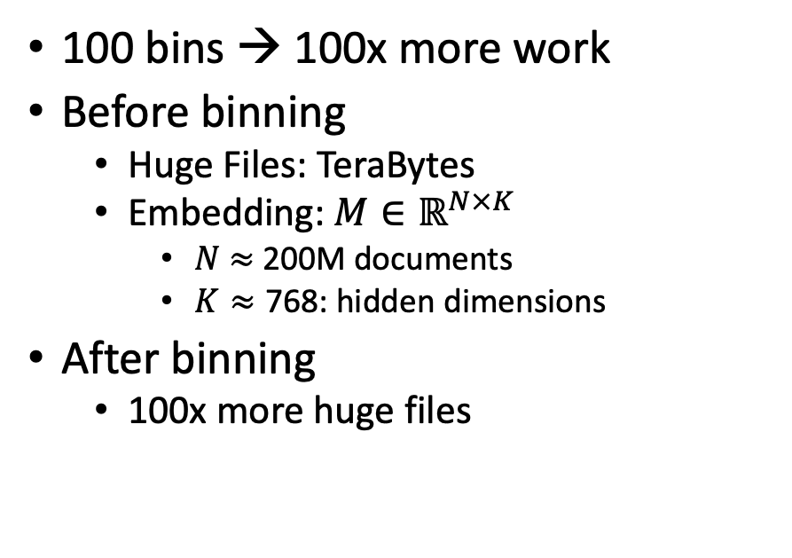
Scale (after binning): Both a Blessing and a Curse
Curse (Ben’s Problem)
Blessing (Abteen & Peter’s Lucky Day)
100 bins → 100x more work
Before binning
Huge Files: TeraBytes
Embedding: $M∈ℝ^{N×K}$
$N$ $≈$ 200M documents
$K≈\text{768}$: hidden dimensions
After binning
100x more huge files
Abteen:
Perplexity varies by bin
in systematic ways
Peter:
Use bins to show
Short-term forecasting is easier
than long-term forecasting
Better together:
Text is more useful
when links are least useful
(small graphs)

Slide 53
Deliverables
GitHub:
massive (but needs editing)
slides, code, reading list
pointers to large files on Globus
Web Server
Recommendations
Input: queries for documents
Output: recommendations (docs)
What Should I read? Cite?
Resources
Data behind web server:
citation graph
embeddings
indexes for approx. nearest neighbors
pairs of corpusIds with large cosines
all of the above for
Specter1, Specter2, SciNCL, ProNE
x100 bins for ProNE
Evaluations & Benchmarks
Intrinsic: Perplexity, Random Walks
Extrinsic: Local Citation Prediction

Slide 54
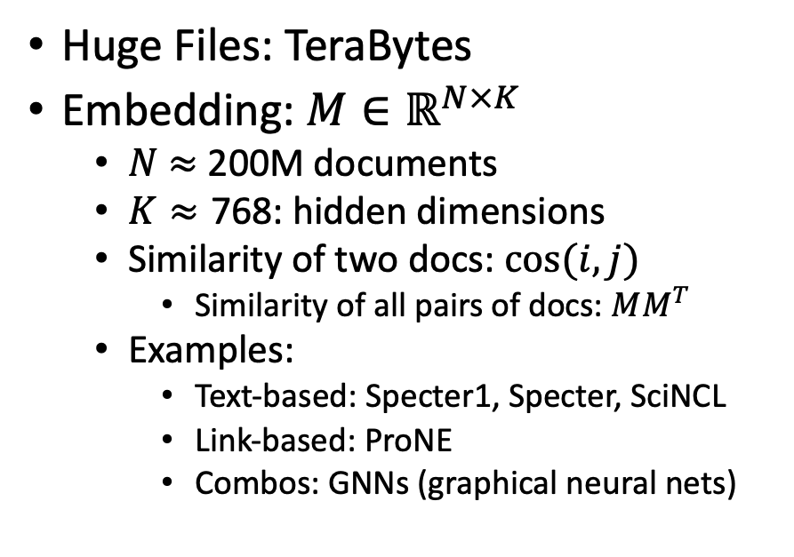
Scale: Both a Blessing and a Curse
Curse
Blessing
Huge Files: TeraBytes
Embedding: $M∈ℝ^{N×K}$
$N$ $≈$ 200M documents
$K≈\text{768}$: hidden dimensions
Similarity of two docs: $cos(i,j)⁡$
Similarity of all pairs of docs: $MM^{T}$
Examples:
Text-based: Specter1, Specter, SciNCL
Link-based: ProNE
Combos: GNNs (graphical neural nets)
Network Effects (Metcalfe’s Law)
Rich get richer
Approximate Nearest Neighbors
Works better on larger graphs
Citation Recommendation
Forecasting with text-based + link-base works better
Year prediction
Text-based + link-base works better

Slide 55
Production Runs
Ben Irving

Slide 56
Scale (after binning): Both a Blessing and a Curse
Curse (Ben’s Problem)
Blessing (Abteen & Peter’s Lucky Day)
100 bins → 100x more work
Before binning
Huge Files: TeraBytes
Embedding: $M∈ℝ^{N×K}$
$N$ $≈$ 200M documents
$K≈\text{768}$: hidden dimensions
After binning
100x more huge files
Abteen:
Perplexity varies by bin
in systematic ways
Peter:
Use bins to show
Short-term forecasting is easier
than long-term forecasting
Better together:
Text is more useful
when links are least useful
(small graphs)

Slide 57
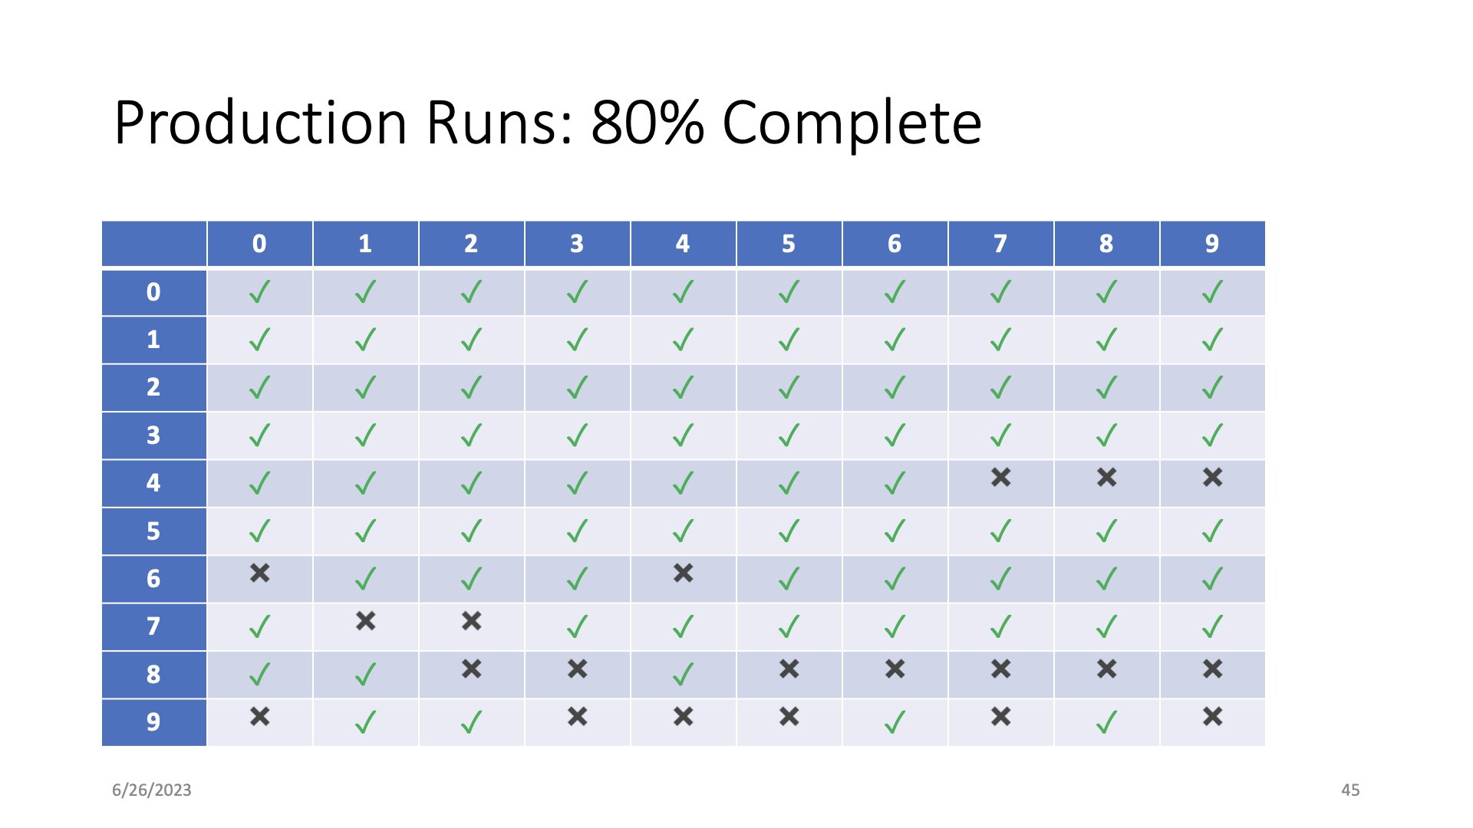

Slide 58
Overview
What I’m working on
Optimization stuff
Starting on related work stuff
Notes:
Ben

Slide 59
Model and limitations
Limited space (<= 2 TB per job)
Limited time (<= 1 day per job)
Without dividing code: 2 TB of memory, 3.8 days
Prefactor
Prone.py
Chebyshev
Finish step
Notes:
Ben

Slide 60
Optimizations
Cython
float32 → float16
Notes:
Ben

Slide 61
Cython
Superset of Python (use more C in Python)
Still runs in Python runtime, but not compiled to Python bytecode. Instead compiled to native machine code (whatever your microprocessor interprets)
Original code
PVM
Machine code
Notes:
Ben
For instance, . Cython compiler doesn’t call python torch library when releasing the global clock is released.

Slide 62
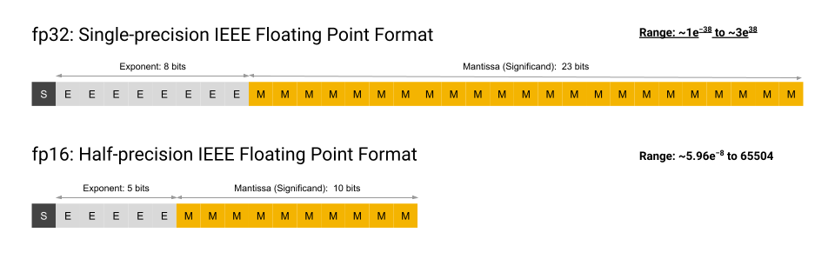
Float32 → Float16
4 decimal places (for float16) vs 8 (for float32)
Problem: (A lot of cpus don’t support it, particularly x86 architectures)
Courtesy of Google
Notes:
Ben

Slide 63
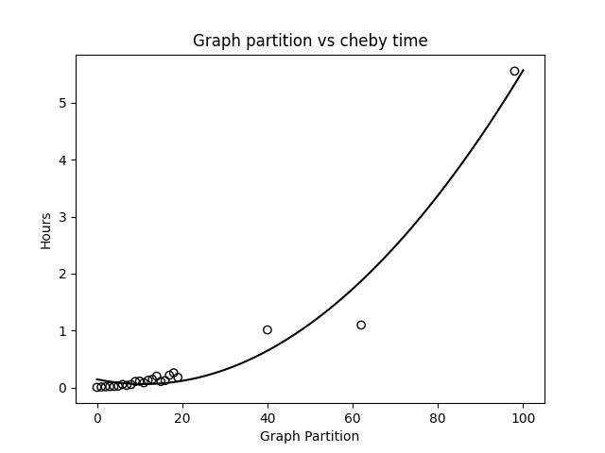
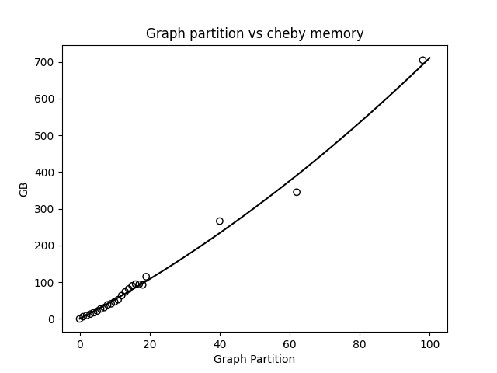
Pre-optimization (cheby step)

Slide 64
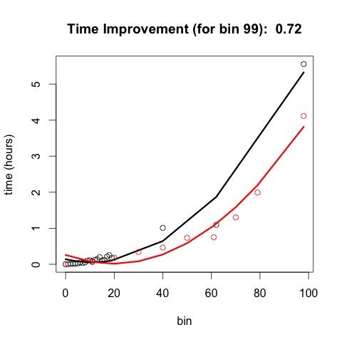
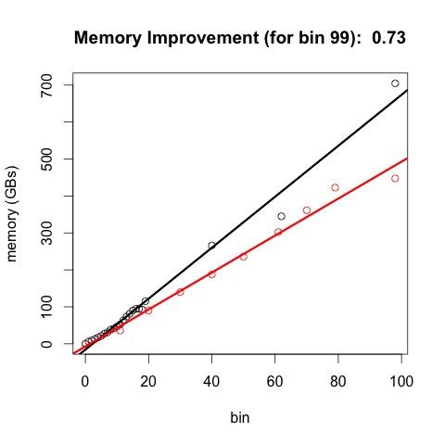
Post optimization (red stuff)
Notes:
Ben
(generally speaking, memory utilized is some simple multiplication of the input mem ← plot this out)

Slide 65
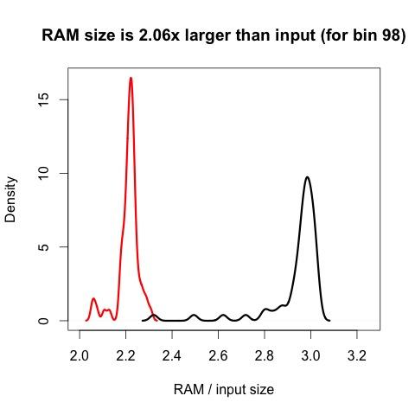
RAM comparison (density)

Slide 66
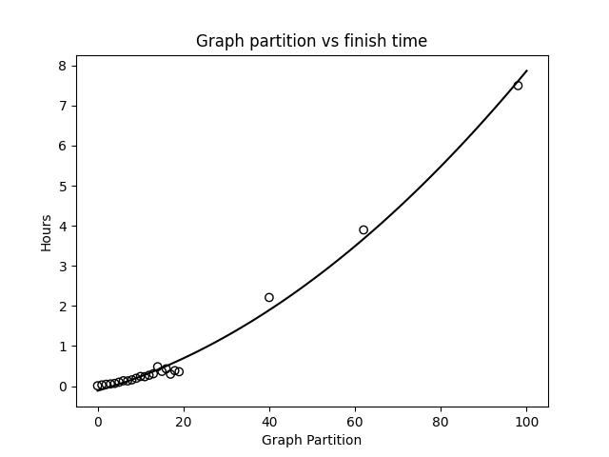
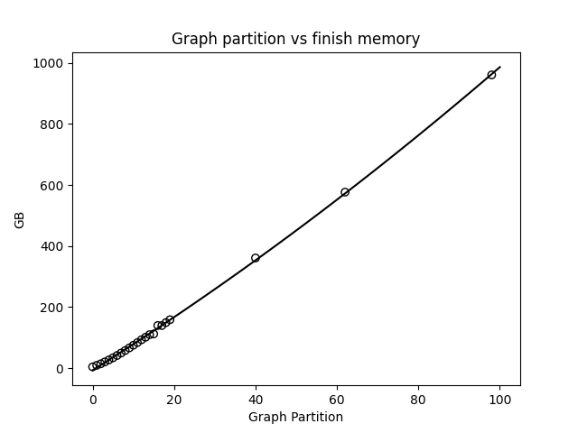
Pre-optimization (finish step)

Slide 67
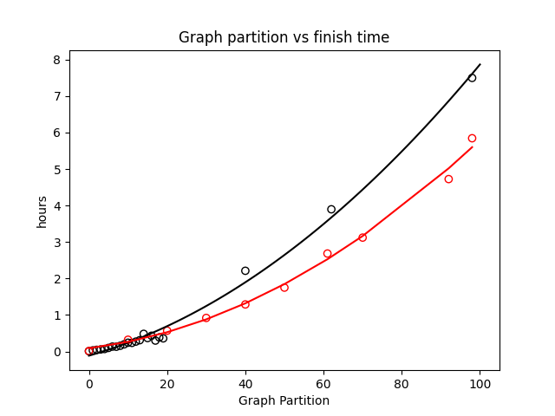
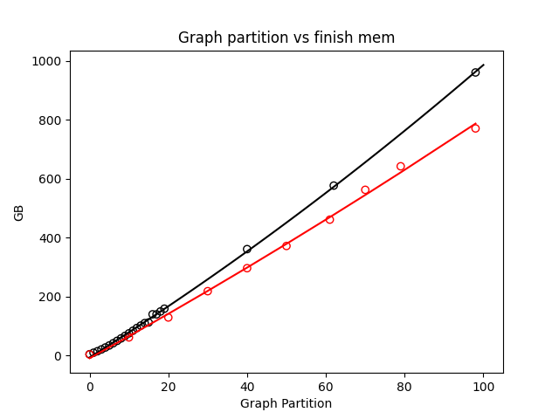
Finish with optimizations (red line)
Notes:
Ben

Slide 68
Conclusion: Bins → Big Effort (but worth it) Come back after break to see why

Slide 69
Related Work Experiments
get_paper_embedding(sample_paper)
model
Paper
Introduction Ref1, Ref2, Ref3
Related Work Ref4, Ref5, Ref6
Conclusion Ref7, Ref8, Ref9
Intro References Vector = 3 References
Compare and Predict
Rel Work References Vector = 3 References
Conclusion References Vector = 3 References

Slide 70

Related Work Experiments (Before)

Slide 71

Deeper Networks (with layernorm, and GELU activation)
With improvements, V_predic now outperforms V_rw in 76.2% of cases.

Slide 72
thanks

Slide 73
backup

Slide 74
Example: 1 cites 2, 2 cites 3, … 5 cites 6
Traditional Train-Test Split (Non-Causal)
idx | Pub Year | Paper Title
1 | 2018 | [...] Photofragment imaging
2 | 2016 | Convenient probe of S(1D2)[...]
3 | 2005 | Megapixel ion imaging [...]
4 | 2003 | Direct current slice imaging [...]
5 | 1995 | profiles of Cl(2Pj) photofragments [...]
6 | 1988 | Adiabatic dissociation of [...]
Proposed Train-Test Splits (Causal)
Notes:
No asymmetry of time - how to reduce to a soundbite
Audience soundbites
‘Almost all studies in ml do test-train split’ that’s a bad idea when you have time

